Slide 1
Grant Management Training 2019
Grant Development, Management and Compliance

Slide 2
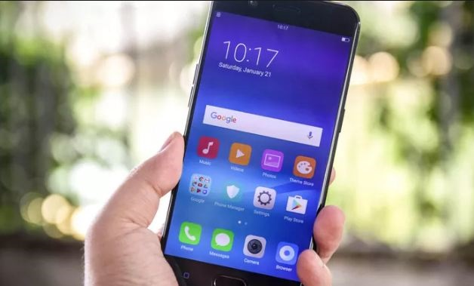
Please take out your smart devices.
Type in URL
Ready…
Set…
Post
Go to PollEv.com/
samanthaurie989, and wait for the poll to be active.
Or TEXT SAMANTHAURIE989 to 22333 to join.

Slide 3
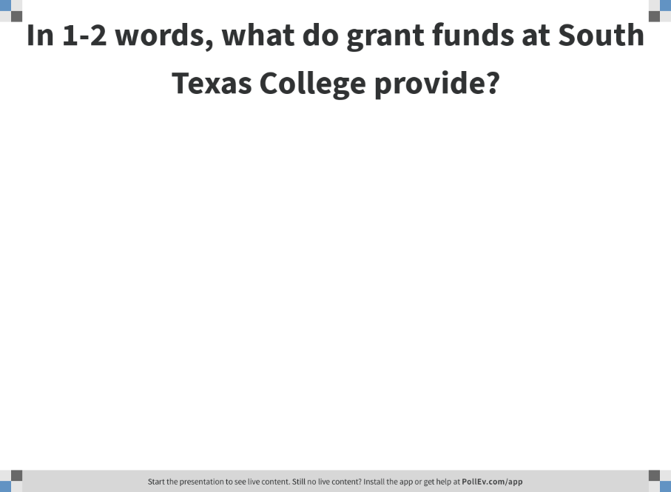
Notes:
Poll Title: In 1-3 words, what do grant funds at South Texas College provide?
https://www.polleverywhere.com/free_text_polls/mSmHWQe9auQo5BR2wUt0N

Slide 4
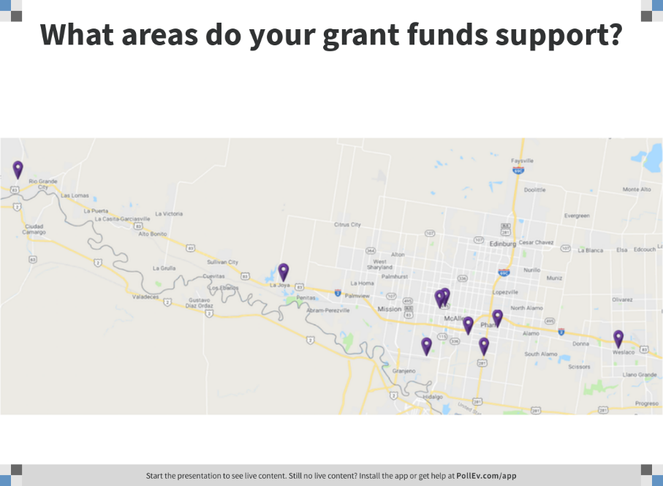
Notes:
Poll Title: What areas do your grant funds support?
https://www.polleverywhere.com/clickable_images/YC9pvIujNyMfbgC8HWk1h

Slide 5
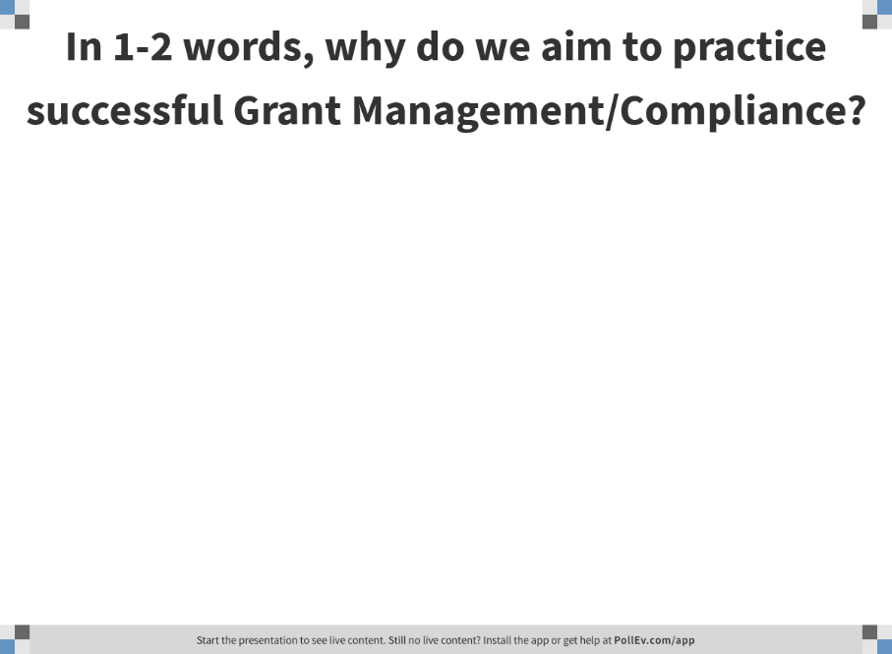
Notes:
Poll Title: Why do we aim to practice successful Grant Management/Compliance?
https://www.polleverywhere.com/free_text_polls/4aDrG7jrduQKKR9gdkqu0

Slide 6

Why are grants important?
Grants for South Texas College align to the Mission and Strategic Directions of the College.
They provide educational opportunities, enhance student programs, and can improve or expand facilities.
Notes:
With Statement 1: A grant is a resource that STC uses to fulfill its purpose to address and improve important issues within our community.

Slide 7

Why is effective Grant Management and Grant Compliance important?
Effective grant management is important because departments need to ensure that they meet the goals and deliverables committed to when proposing and signing the contract.
Effective grant compliance is important because it safeguards the College by ensuring transparency and accountability while complying with the requirements of the grant and the institution’s policy/procedures when completing grant activity.
Notes:
With Statement 2: In addition to abiding by not only the grant terms and clauses but STC’s policies and procedures and state and federal laws.

Slide 8
Compliance Support for Active Grants
63 Current Active Grants - $15,435,801.87
19 Closed Grants in FY 19 – $5,180,888.50
Approximately 30 PIs
Approximately 40 FMs
4 Grants Being Presented to Board in August 2019
  (Approximately $4 Million)

Slide 9


Department of Grant Development, Management and Compliance (GDMC)
Our Purpose:
  To expand the capacity of South Texas College and advance its vision, mission and goals through effective grant development, management and compliance.

Slide 10

GDMC Training Goals
Participants will gain a better understanding for grant consideration
Principal Investigators will gain a better understanding of the post-award process
Financial Managers will gain a better understanding of how to support the Principal Investigators and grant activity with specific emphasis on fiscal management
Support staff will gain a better understanding on processes related to grant activity

Slide 11
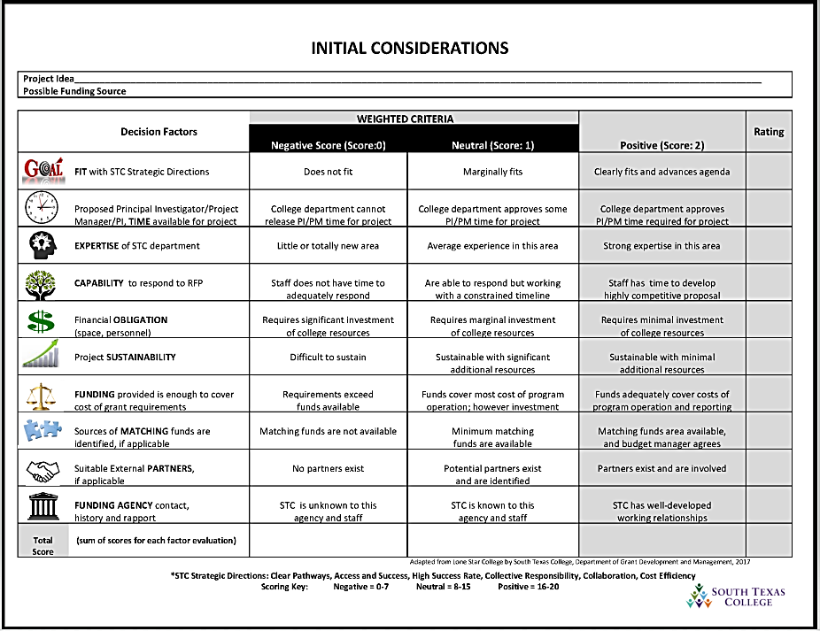

Slide 12
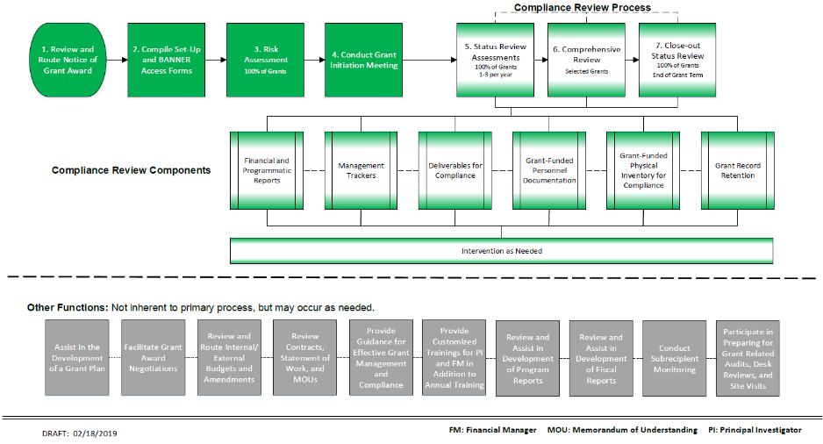
Grant Compliance Support
Assists with ensuring that implementation, management and monitoring are accomplished during the post-award process.
Notes:
The items in the following slides will show department involvement in steps.
Please refer to your booklet

Slide 13

Prepare and Set‐Up Fund and Account Forms
Department will work with GDMC to fill out the forms:
Request to Set-up a New Grant Fund BO-4201
  Set-up a Fund in BANNER
Request for Grant Budget, BO-4200
  Set-up a budget in BANNER
  Specified Account pools
  Financial Manager will gain BANNER Access

Slide 14
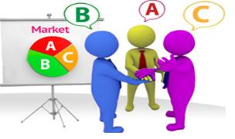

Cost Sharing Types
  Matching funds are set to be paid in a designated amount to the project available from other sources.
  In-Kind support is when the support comes from available resources by the applicant.
  Leverage: support from available resources by an entity outside of the applicant.
When there is an intent to purchase something specific or fund specific personnel, etc. and share in the expense with the grantor.
The terms cost sharing, in-kind, and matching are often used interchangeably, but sometimes slightly differ in meaning.
AWARD
Notes:
Cost sharing or matching means that a portion of project or program costs is not covered by the grant.
Cost share includes cash contributions from the organization that received the grant for the project, in-kind contributions from third- parties, and matching funds from third parties.
In-kind contributions' means the value of non-cash contributions provided by non-Federal.
in-kind contributions may be in the form of real property, equipment, supplies and other expendable property, and the value of goods and services directly benefiting and specifically identifiable to the project or program.
These are part of the direct expenses of the project and usually are reflected on the cost-share (not the federal or grant) side of the budget.
Matching funds are cash contributions to the project, to the cost- share side of the project. If they are eligible, the College can match the grantor based on a specified percentage or dollar equivalency relative to the agency provided budget.

Slide 15
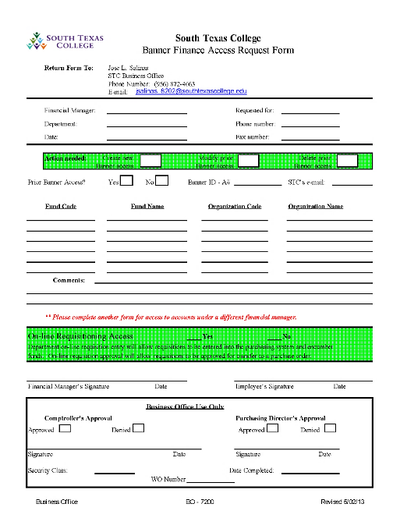
Compile Approved Banner Access Forms
Department will fill out form(s) and send to GDMC
  Banner Finance Access Request Form, BO-7200
  Principal Investigator will gain access to view
  Support Staff for requisitioning access
    Equipment
    Supplies
    Travel

Slide 16

Grant Initiation Meeting
Ensures everyone has a clear understanding of the grant requirements and to process the forms for fund set-up.
Project Goals and Objectives
Internal Owners: PI, FM, and support staff with BANNER Access
Reporting
  Programmatic
  Fiscal
Risk Assessment
Fiscal/Program
  Award Amount
  Budget Breakdown
  Deliverables

Slide 17
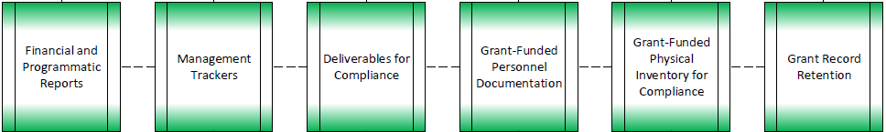

Compliance Review Process
Supports the PI and FM in managing their grants effectively to meet grantor requirements and follow established institutional policies and procedures.
Step 5. Status Review
                Step 6. Comprehensive Review
                Step 7. Close-out Review

Slide 18
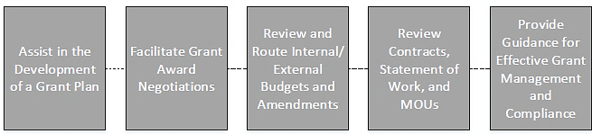
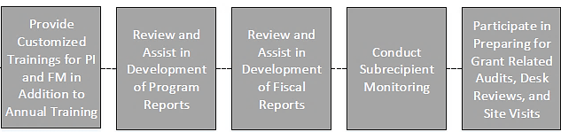
Other GC Functions

Slide 19
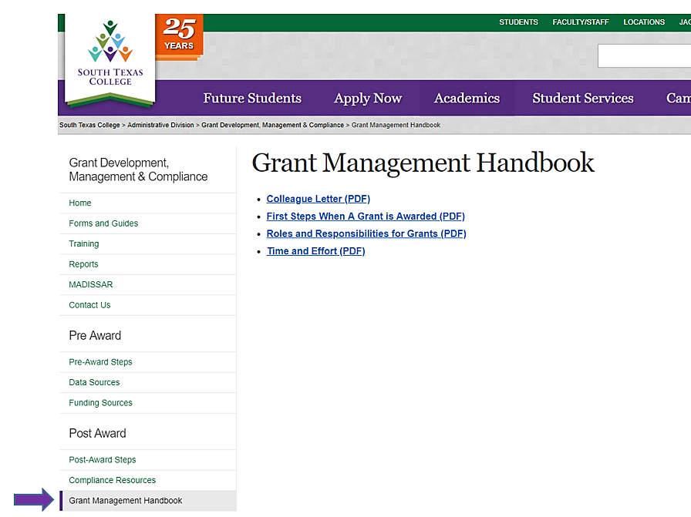
Grant Management Handbook https://admin.southtexascollege.edu/grants/handbook.html

Slide 20
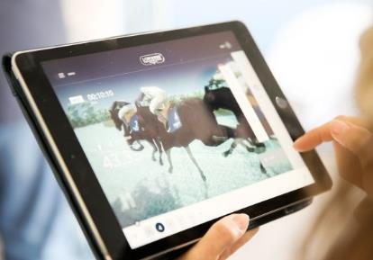
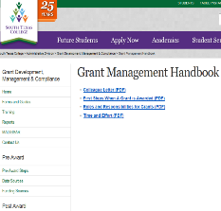
First Steps When a Grant is Awarded
Notice of Grant Award
What does a Notice of Grant Award
include?
Negotiations
Board of Trustees Meeting
https://admin.southtexascollege.edu/grants/handbook.html

Slide 21

Roles & Responsibilities
Project Director (PD)/Principal Investigator (PI)
Financial Manager (FM)
Vice President (VP)
Grant Compliance (GC)
Business Office (BO)
Purchasing and Distribution
Services
Human Resources (HR)
Collective Effort
https://admin.southtexascollege.edu/grants/handbook.html

Slide 22

Grant Roles and Relationships
PI, FM and Support Staff
Grant Accounting
Grant Compliance

Slide 23

Principal Investigator/Project Director Role
Manages and coordinates programmatic/fiscal grant activities for South Texas College in accordance with the scope of the grant.
  Programmatic Responsibilities
  Follow Grant Terms & Conditions
  Execute Grant Deliverables
  Prepare Programmatic Reports
  Fiscal Responsibilities
  Assist with Budget/Amendment Approvals
  Request Banner Access
  Assist with Expenditure Report and Fund Balance Reviews
  Expend 100% of the grant funds within original grant period
  Collect, Review and Approve Faculty and Staff Effort Reports
Notes:
Essentially the PI/PD is the one who supports in ensuring all puzzles pieces go where they should.

Slide 24


Principal Investigator/Project Director Role
Manages and coordinates programmatic/fiscal grant activities for South Texas College in accordance with the scope of the grant.
  College Procedure Responsibilities
  Initiate Requisition Process
  Hire Personnel
  Ensure Inventory Tracking
  Initiate Travel Process
Travel
Guida
nce
Inventory
Requisitions
H
R
Procedures
Grant
Guidance
I
Grants
Purchasing

Slide 25



Financial Manager Role
Works closely with the Principal Investigator to ensure fiscal responsibility throughout the term of grant.
  Approve Expenditures and Budgets
  Ensure Grant Expenses are Reconciled
          Ensure expenditures are within approved budget
          Approve Fiscal Reports for grants
  Follow-up on Inventory Tracking
  Work with Business Office on REQs, POs, INVs, as necessary

Slide 26




Time & Effort
Importance of Time and Effort Reporting
Necessary, Reasonable and Allocable Costs
Time and Effort Selection Process
https://admin.southtexascollege.edu/grants/handbook.html

Slide 27



Slide 28
Effort Reporting
Tracks completion of grant activities for personnel funded by a grantor.
Effort Reporting forms were reviewed by Brustein and Manasevit, PLLC, a firm with expertise with federal grant requirements.
It is a process mandated by the federal government to verify that labor charges to or cost shared on grant projects are accurate, timely, and reflect the actual level of work performed.
  Grant Activity Responsibilities and Commitment
  Personnel Certification
  Personnel Activity Report (PAR)
  Semi-Annual Certification

Slide 29
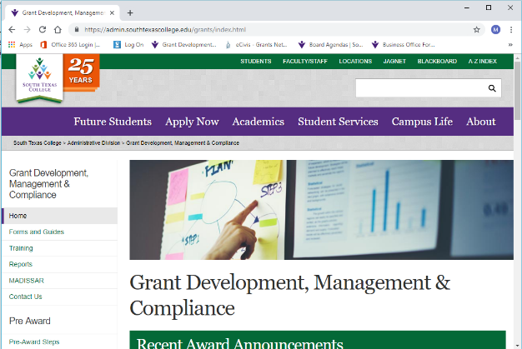
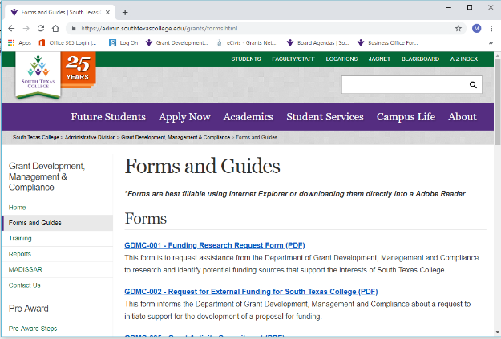
Effort Reporting Resources
On the STC website, in the Department of Grant Development, Management and Compliance webpage, click Forms and Guides on the left menu:

Slide 30
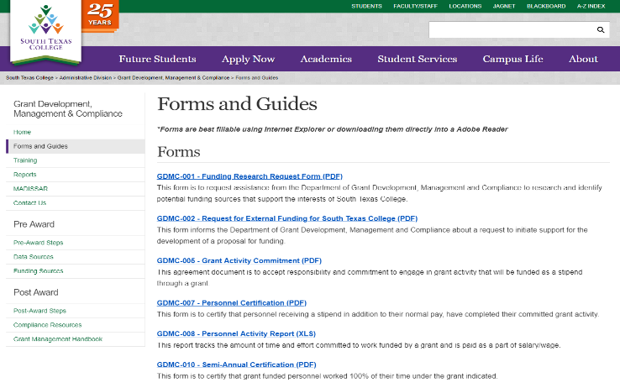
Effort Reporting Resources Cont’d

Slide 31
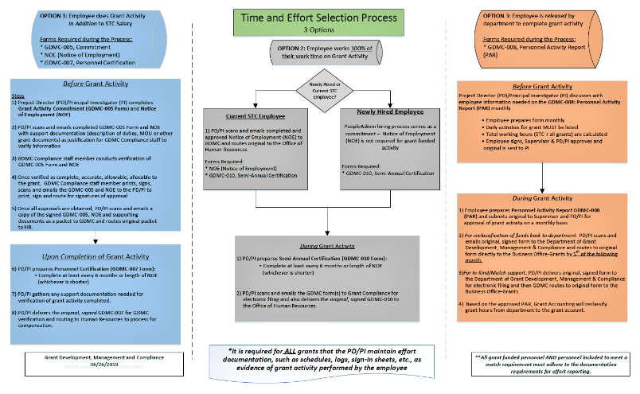
Time and Effort Selection Process

Slide 32
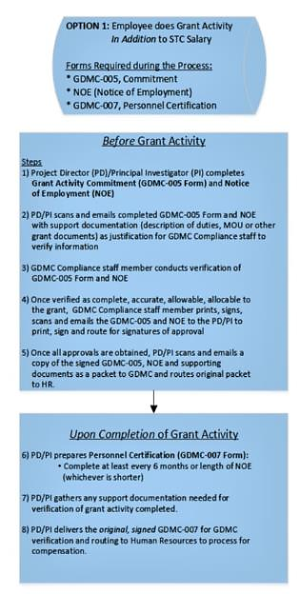
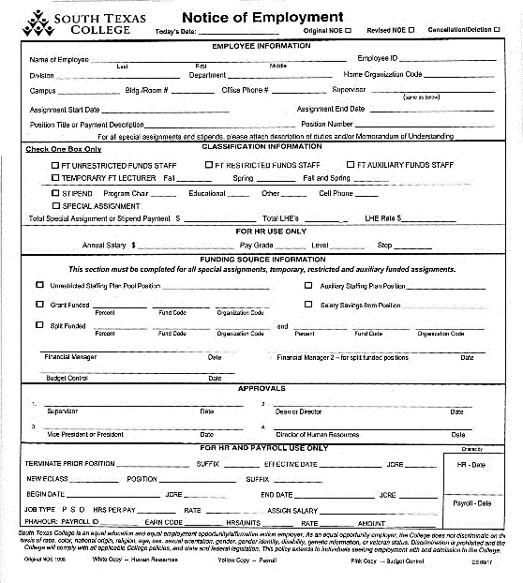
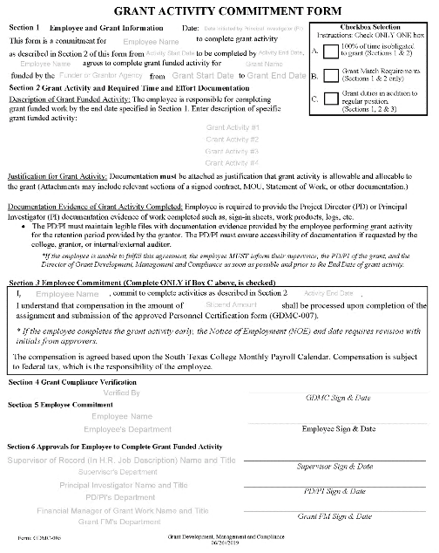
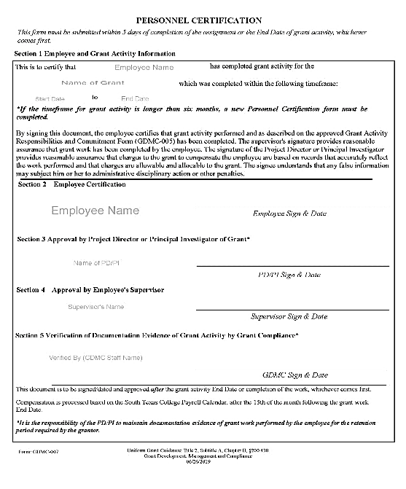


Slide 33
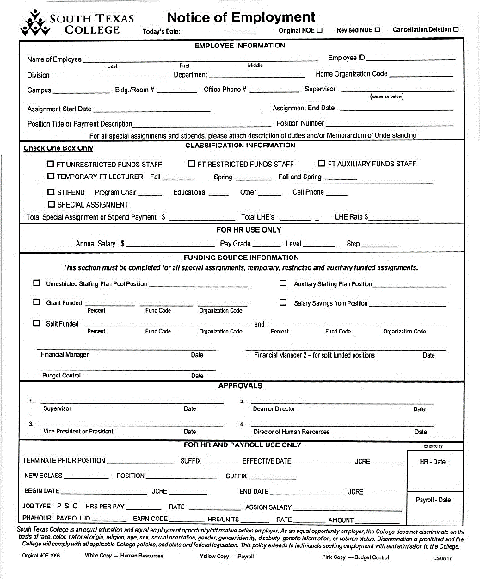
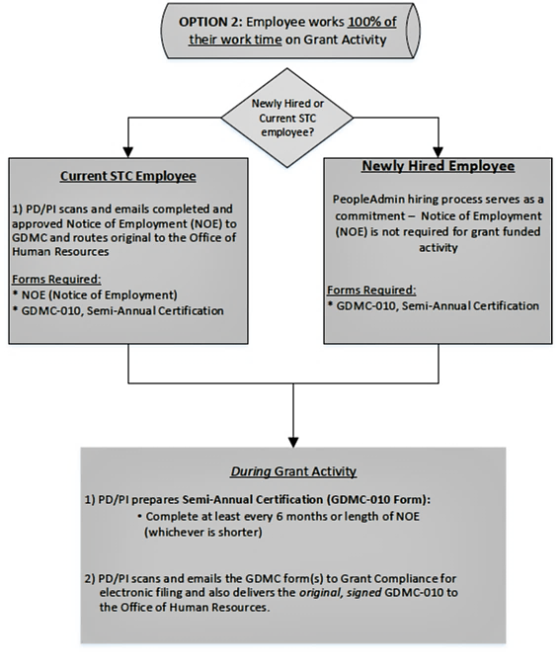
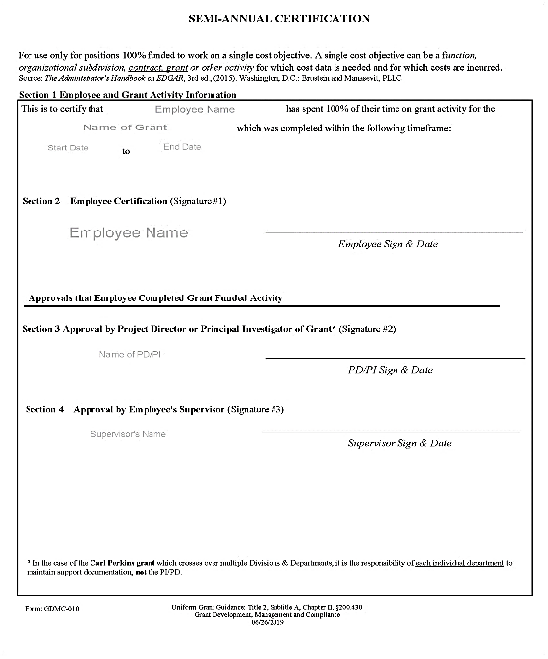



Slide 34
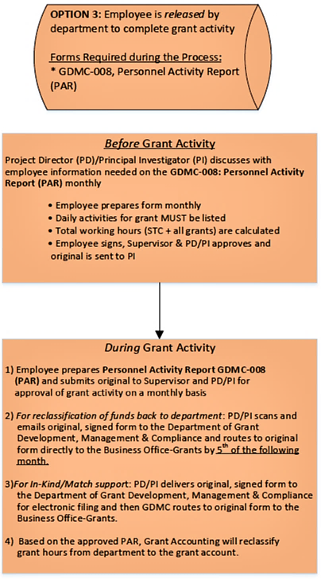
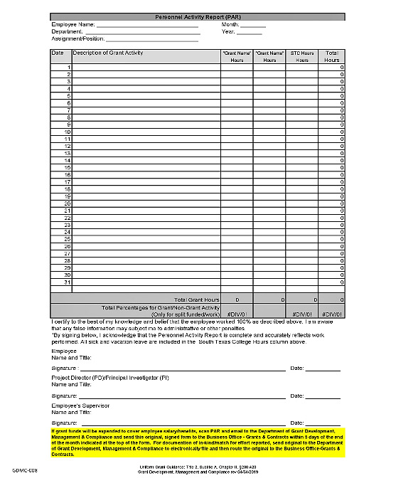

Slide 35

Break Time
15 minutes

Slide 36

Activity Instructions
Review the scenario on your tables
Each table is to find as many errors or items that are missing in policy or procedure in this section
Write down your team’s responses
Discussion will follow

Slide 37
Scenario Activity
On August 20th, 2019, South Texas College was awarded a $375,000 grant award from the Texas Workforce Commission, funded through the Federal Department of Education. The award will begin upon a fully executed contract and is scheduled to end on 12/31/2020. The final signature is done on 09/18/2019.
The Contract calls for Certifications for 160 students in specific CTE career pathways. Pathways include Cybersecurity, Information Technologies and Architectural Design. The grant will provide funding for curriculum development, tuition, fees, books and supplies, a specialty computer and software for each pathway (each one valued at $11,000) as well as money for 1 full time Project Director, recruiting and marketing.
A monthly expenditure report, 4 quarterly reports starting the 1st reporting period of 9/1/2019 and a final close out report and fiscal report due 60 days after the grant date. The grant retention period is 5 years after the grant end.

Slide 38
Activity List-Initiation & Q1
Review Budget to ensure what is being committed in financially feasible
PI/PD completes and routes set-up forms for President’s signature
Work with Purchasing to get 1 quote for equipment
Set meeting with PR/Marketing to start recruitment promotion
Route an NOE and a Grant Activity Commitment form for curriculum development with activity starting August 31st, 2019
Route and NOE and a Grant Activity Commitment form for the 100% grant dedicated PI/PD.
GDMC to prepare set-up forms for new grant (Budget Request, New Grant set-up, Banner Access Request) and route for signatures
PI & FM prepare and facilitate Grant Initiation Meeting

Slide 39
Activity List-Q2, Q3 and Q4
Receive equipment and contact GDMC so they can track the equipment
FM to keep a reconciliation (done at least monthly) to track Expenditure, Commitments (encumbrances) and available Balances
PI and FM reviews expenditure reports sent by Grant Accounting
  This approval is used by Grant Accounting to do fiscal reporting monthly
Prepare each quarterly reports and send to GDMC 1 day before report is due to grantor
Respond to Status review email and link sent by GDMC which will take at least ½ day to complete

Slide 40
Activity List-Close-out/grant retention period
90 days before grant end, PI to receive email and link from GDMC to prepare for closeout
Ensure no expenditures made on or after 02/28/2021
Prepare final programmatic report, sending to GDMC on Feb 27, 2021
Compare Reconciliation to Banner and Final Expenditure report from Grant Accounting
Final programmatic report (final summary of project) should include:
  Synopsis of program successes and challenges
  Pictures and/or Testimonies from students/faculty
  List of Student names, addresses and S.S. numbers to verify who participated
3 years after the grant ends, start destruction of documents

Slide 41
Inquiry Time
Type in URL
Ready…
Set…
Post
Go to PollEv.com/
samanthaurie989, and wait for the poll to be active.
Or TEXT SAMANTHAURIE989 to 22333 to join.

Slide 42
Tips on Effective Grant Management at South Texas College
Document, document, document
Monitor your progress (expenditures, training or deliverable goals)
  Be diligent in monitoring subawardees
Know your proposal and adjust when necessary (input from GDMC and Grant Accounting)
  Create a work plan for all grant activities
Be realistic and timely in reporting
Communication to the contract manager
Come to Grant Development, Management and Compliance, before we come to you

Slide 43

Grant Management
Personnel/Human Resource Processes
Purchasing, Requisition and Inventory
Travel Procedures and Tips
Financial Management
  Banner, Reconciliations, Fiscal Reporting
Progress Reports
Recruitment
Evaluation
Grant Record Retention

Slide 44
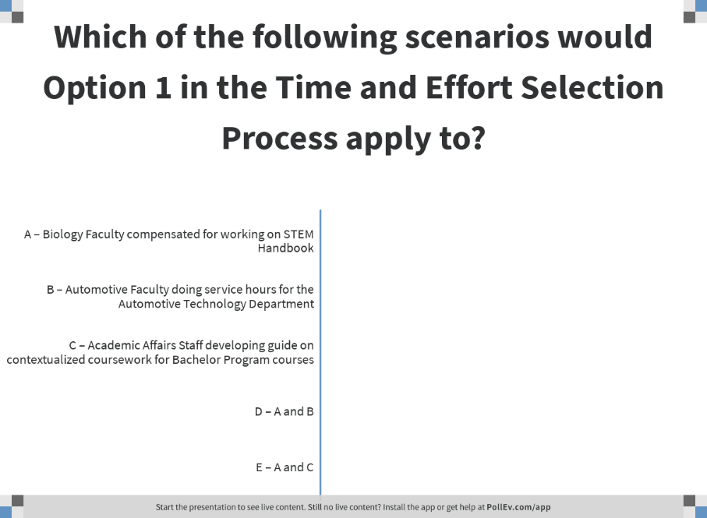
Notes:
Poll Title: Which of the following scenarios would Option 1 in the Time and Effort Selection Process apply to?
https://www.polleverywhere.com/multiple_choice_polls/6jiif5M406Tvl61atUR5W

Slide 45
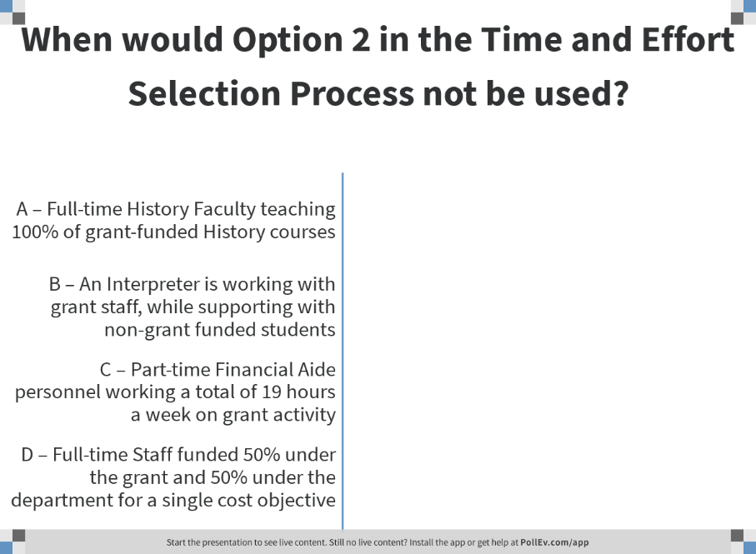
Notes:
Poll Title: When would Option 2 in the Time and Effort Selection Process not be used?
https://www.polleverywhere.com/multiple_choice_polls/LD7JBCJ8GdWEfFlRIL3lO

Slide 46
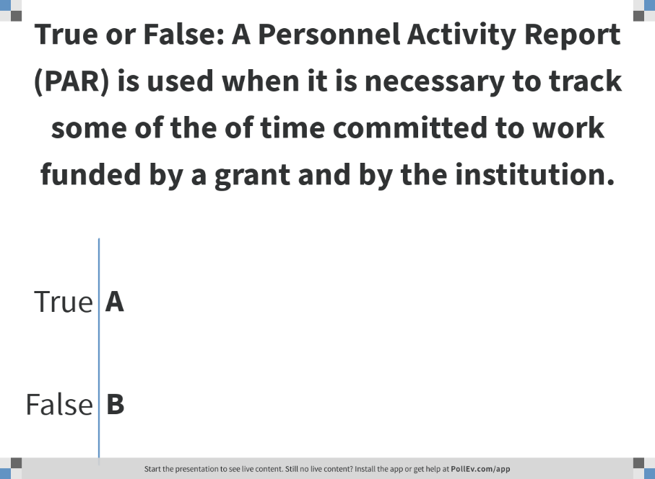
Notes:
Poll Title: True or False: A Personnel Activity Report (PAR) is used when it is necessary to track some of the of time committed to work funded by a grant and by the institution.
https://www.polleverywhere.com/multiple_choice_polls/AY1MhJIGg2V94H2q2L5S7

Slide 47
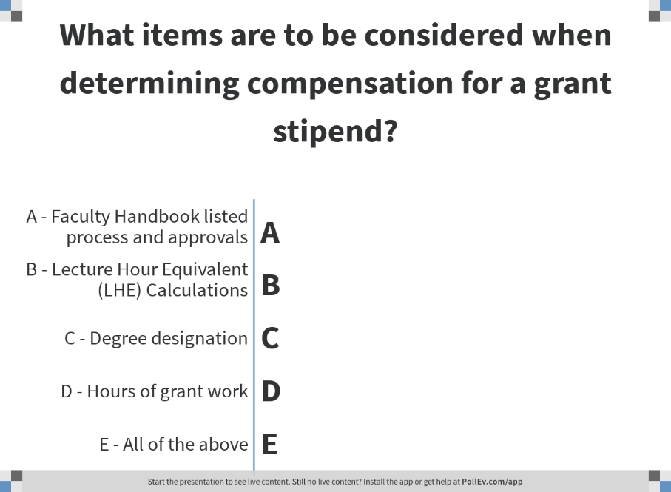
Notes:
Poll Title: What items are to be considered when determining compensation for a grant stipend?
https://www.polleverywhere.com/multiple_choice_polls/fP1dsOJCrSDUqfpktBOPD

Slide 48
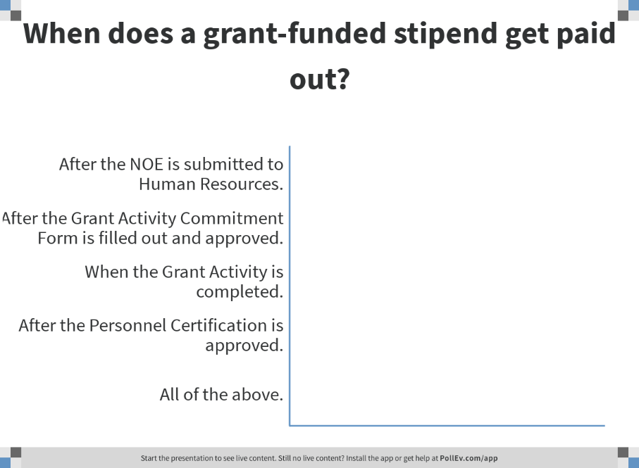
Notes:
Poll Title: When does a grant-funded stipend get paid out?
https://www.polleverywhere.com/multiple_choice_polls/TrRaP5aUUAZ6DtC

Slide 49
Personnel/
Human Resources
Payroll Cycle/Deadlines
Lecture Hour Equivalent (LHE) calculation within the Faculty
Handbook
Job descriptions
Grant approval process varies from the standard STC process
Recommendation Committee Guidelines
Keep in mind Personnel Effort Reporting for grant funded personnel also apply to personnel that are not funded under the grant, but are doing grant effort and are part of in-kind, match, etc.
Notes:
Two Poll Everywhere questions.
1. what is involved in the LHE
Degree designations,
Hrs Grant Effort
Conversion to LHE
2. Which of the Following statements is accurate?

Slide 50
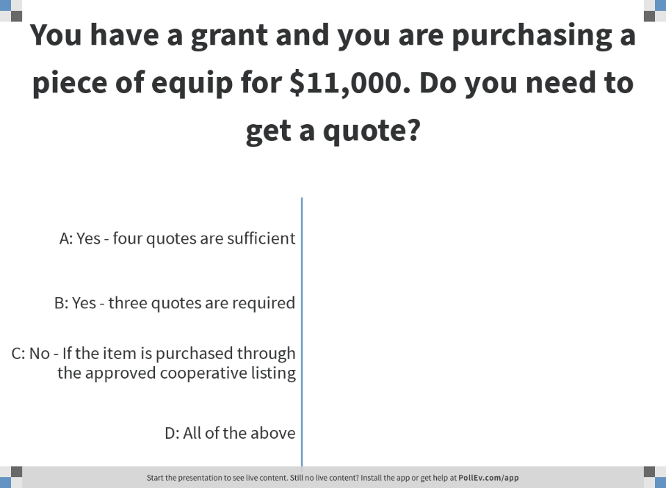
Notes:
Poll Title: You have a grant and you are purchasing a piece of equip for $11,000. Do you need to get a quote?
https://www.polleverywhere.com/multiple_choice_polls/4UbDORbgGFFboBrpevWIt

Slide 51
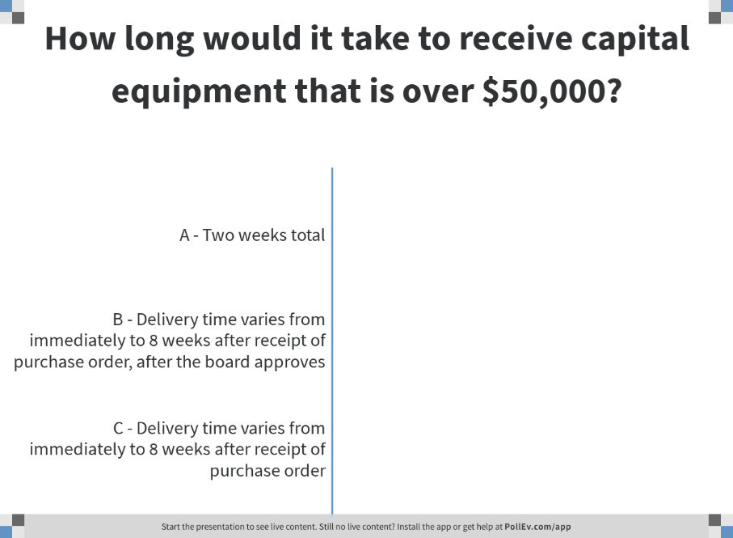
Notes:
Poll Title: How long would it take to receive capital equipment that is over $50,000?
https://www.polleverywhere.com/multiple_choice_polls/csU8oKWDWkEDlK6ulY5yM

Slide 52
Purchasing
Purchasing Levels
  < $3K written quote
  $3K - $49,999 – Three (3) written quotes required
  $50K> Competitive Bidding Process and Board Approval Required (Grantor Approval)
Consultant/Speaker Services - Needs Approval
Sole Source Vendor
Grant Timeline/Grantor Forms
Notes:
Poll Everywhere
Have a grant that you’re purchasing a piece of equip for $11K. Do you need to get a quote?
How long would it take to get capital equipment? (Mult. Choice)

Slide 53
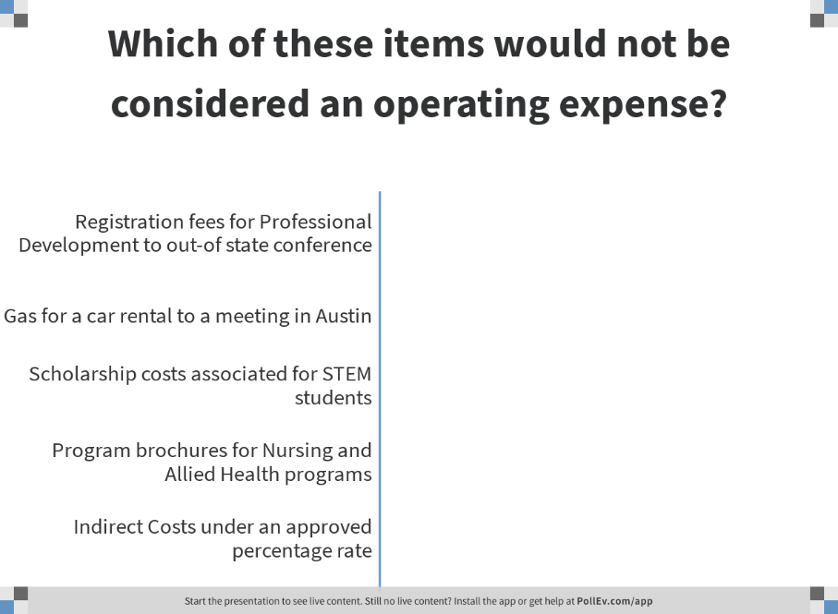
Notes:
Poll Title: Which of these items would not be considered an operating expense?
https://www.polleverywhere.com/multiple_choice_polls/POJ6mHi2tUewUznau96Rg

Slide 54
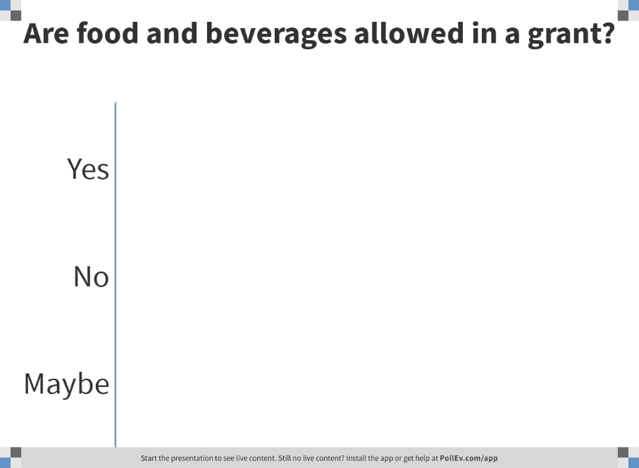
Notes:
Poll Title: Are food and beverages allowed in a grant?
https://www.polleverywhere.com/multiple_choice_polls/I96XhzCak8Unp6K96dduP

Slide 55
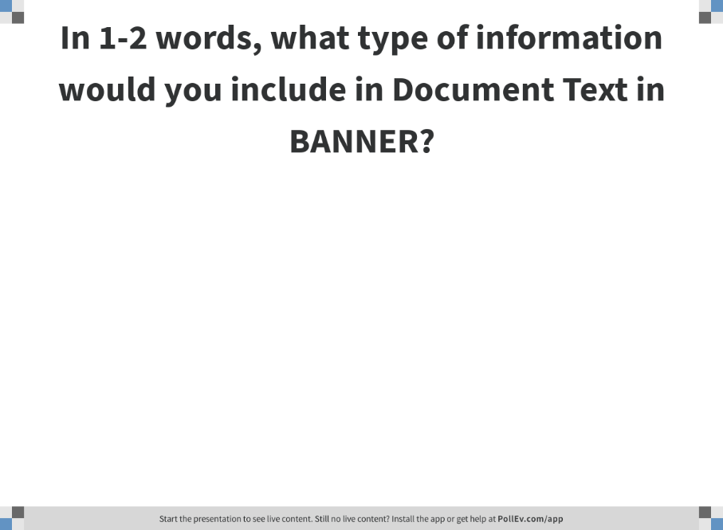
Notes:
Poll Title: What type of information would you include in Document Text in BANNER?
https://www.polleverywhere.com/free_text_polls/Wfy2lmDD9eM5Swnnp8sYH

Slide 56
Requisition
Fill out document text as accurately as possible
  Date and Location, if applicable
  Name of Event, if applicable
  Name of the Grant
Remember the Fund and ORG Numbers
If a requisition is made and is meant to contribute to grant effort/activity, then include notation within the document text and notify Grant Accounting of the list of requisition, PO, invoice numbers, etc.
Notes:
Poll Everywhere
1. What type of information would you include in the document text?
Audience Tips

Slide 57
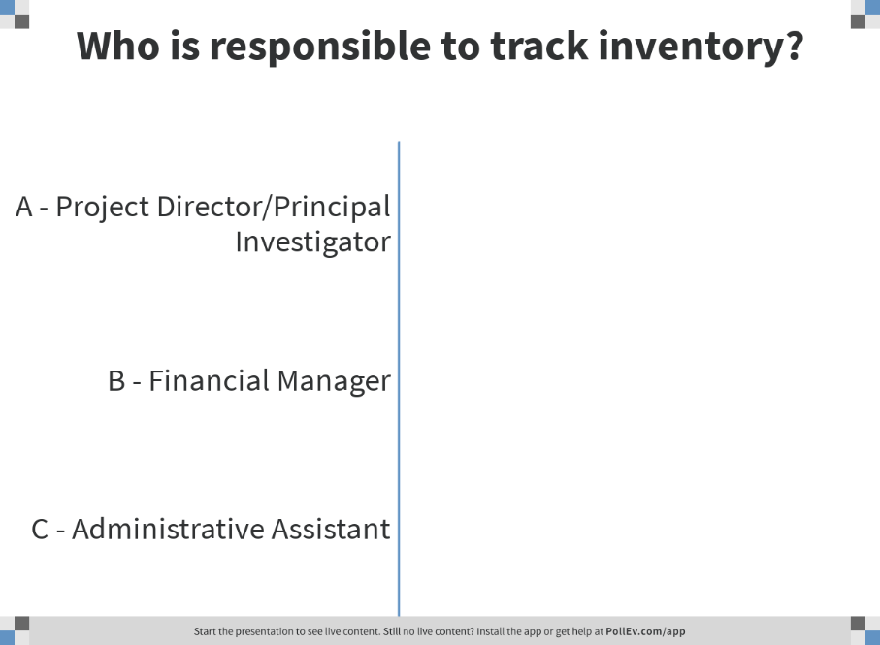
Notes:
Poll Title: Who is responsible to track inventory?
https://www.polleverywhere.com/multiple_choice_polls/gR8iAx3EZyguI1rw8v8eG

Slide 58
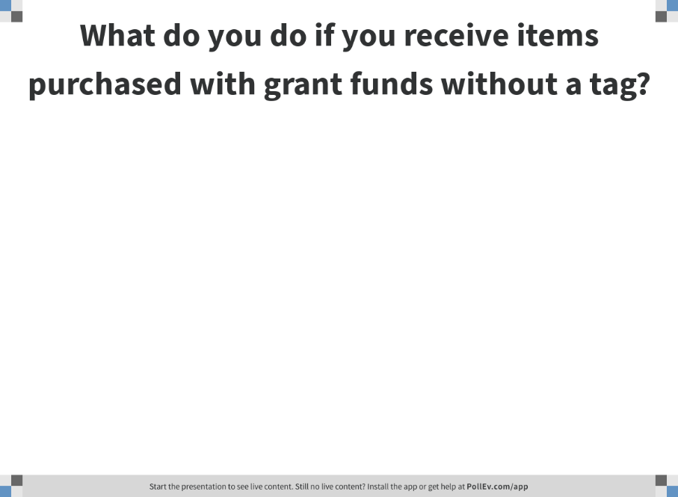
Notes:
Poll Title: What do you do if you receive items purchased with grant funds without a tag?
https://www.polleverywhere.com/free_text_polls/mLXUkSeyPxjGStiBmhKz0

Slide 59
Inventory
Ensuring the tracking of Inventory Items is the shared responsibility of the PI and the FM.
Items are verified when orders are received and tagged with proper tag. Tagged item information is recorded on a log for later approval.
      Items are tagged based on cost over/under $1,000.00, regular account, grant account and it is recorded in its proper log for future approval in fixed assets module.
Inventory ($1,000 and above ) items = Silver Tag,
Any grant item = Green Tag,
Any grant-inventory ($1,000 and above) items = Silver & Green Tags
Notes:
Poll Everywhere
Who is responsible for tracking inventory? (FM/Custodian must safeguard all assets)
What do you do if you receive items purchased with grant funds without a tag? (Call Receiving)

Slide 60
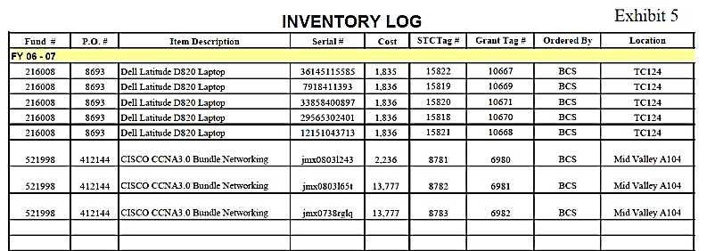
Sample Inventory List
Below is the link for STC’s Fixed Asset Procedures:
http://finance.southtexascollege.edu/purchasing/receiving/procedures.html

Slide 61
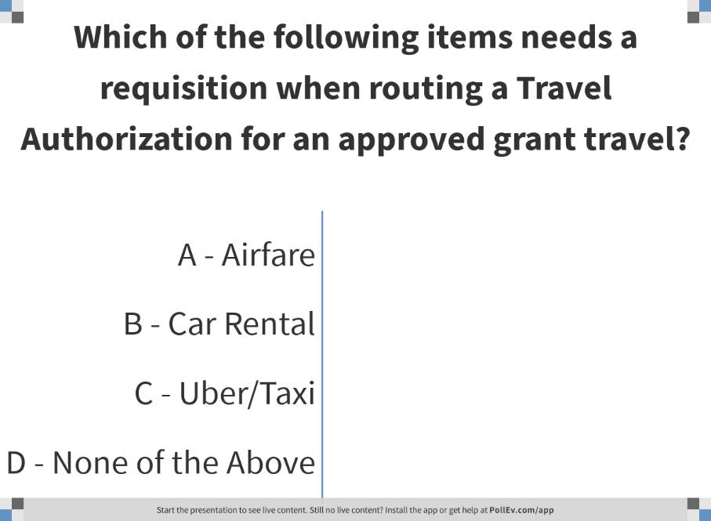
Notes:
Poll Title: Which of the following items needs a requisition when routing a Travel Authorization for an approved grant travel?
https://www.polleverywhere.com/multiple_choice_polls/OjWek7GxmcmJeI54iKlHj

Slide 62
Travel
Electronic versus Paper
Refer to General Service Administration
Do not include tips
Include all supporting documentation
Check Grant Award for allowability of costs
Don’t forget the 15 day rule
Notes:
Poll Everywhere
Which of the following items needs a requisition when routing a travel authorization for an approved grant travel?
Airfare
Car rental
Uber/Taxi
None of the Above

Slide 63
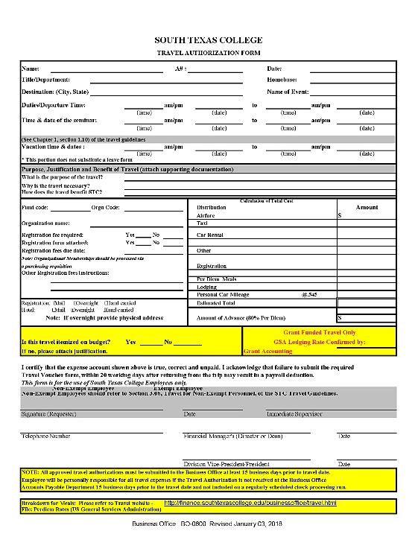
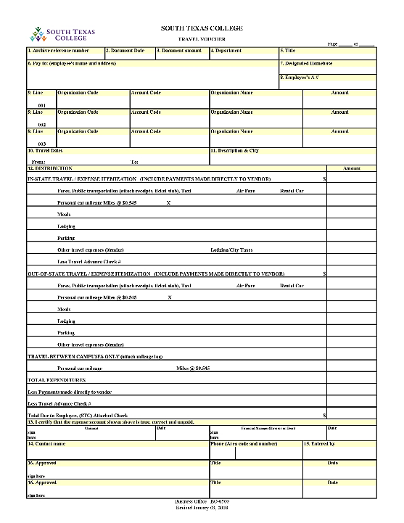
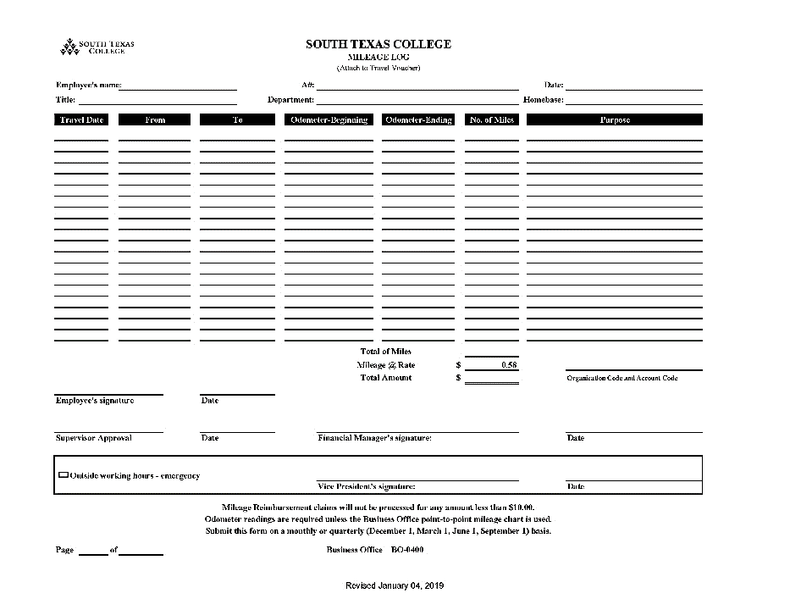
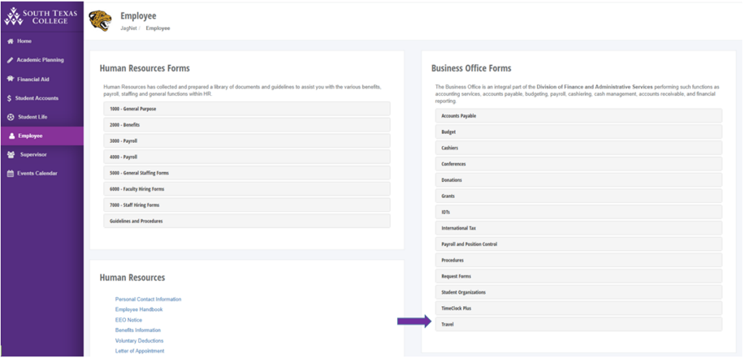
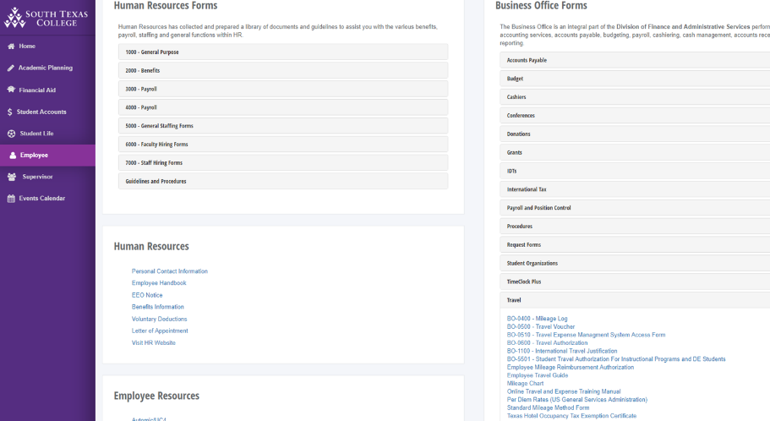
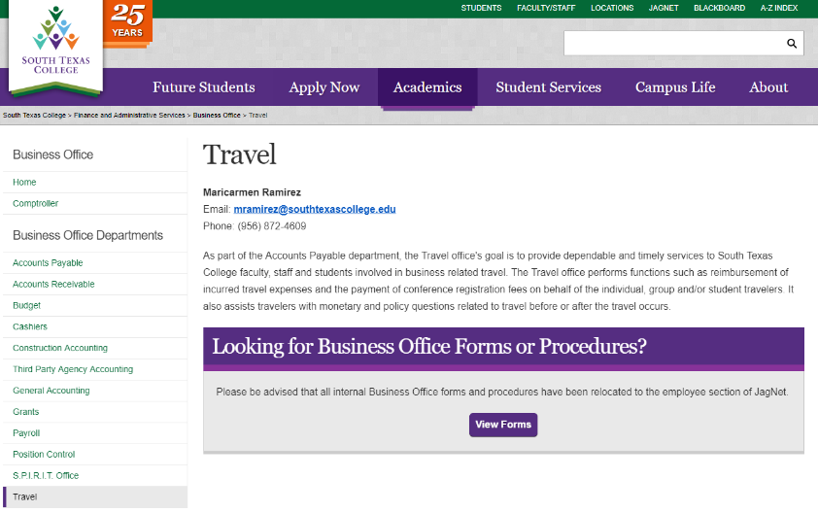
Travel Forms
For more information, please visit: https://finance.southtexascollege.edu/businessoffice/travel.html

Slide 64
Banner
Helpful BANNER Screens:
    FRIGITD – Grant Inception to Date
    FRIGTRD – Transaction Detail
    FOIDOCH – Document History
    FGIOENC – Encumbrance List
    FGIENCD – Detail Encumbrance Activity
    FOIAPHT – Approval History (who’s approved)
    FOAAINP – Document Approval (who’s pending)
Notes:
Poll Everywhere ?

Slide 65
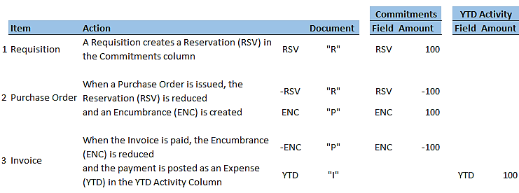
Transaction Cycle

Slide 66
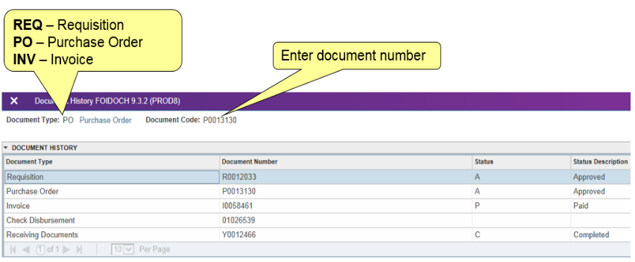
FOIDOCH - Associated Documents

Slide 67
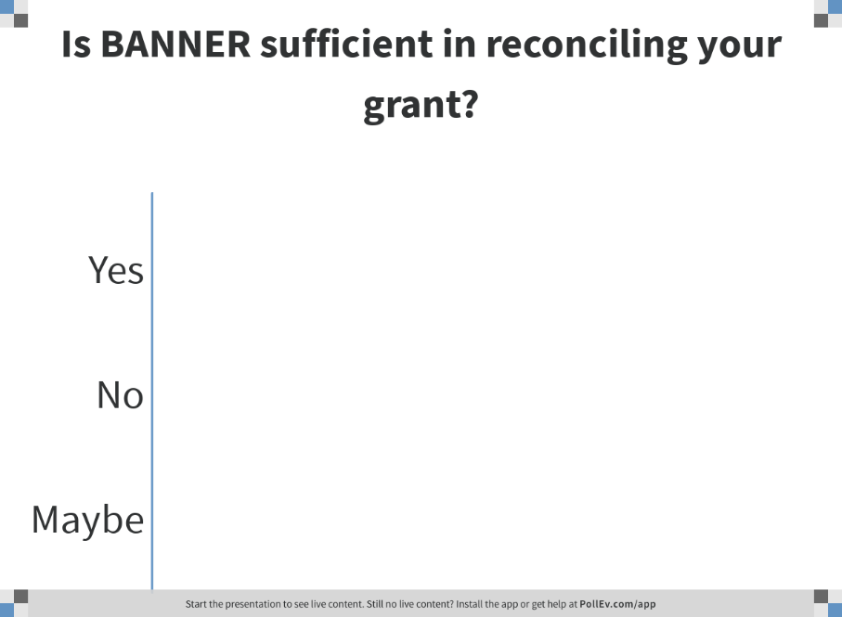
Notes:
Poll Title: Is BANNER sufficient in reconciling your grant?
https://www.polleverywhere.com/multiple_choice_polls/NfViCR6LArSBlIwYU7o3p

Slide 68

Notes:
Poll Title: Why is completing a reconciliation important when you have budgets?
https://www.polleverywhere.com/multiple_choice_polls/S8rg3Zr2HXSmwlW5x6g56

Slide 69
Reconciliation
Keep an up-to-date reconciliation
    Review available funds
    Review encumbrances
    Forecast Activity
Notes:
Poll Everywhere
1.Is Banner sufficient for reconciling your grant?
2.Why is completing a reconciliation important when you have budget?

Slide 70


Slide 71

Notes:
Poll Title: Who is responsible for approving the fiscal reports to the grantor?
https://www.polleverywhere.com/multiple_choice_polls/dprfuNx4UMkbwT4Yws4VL

Slide 72

Fiscal Reporting
Who is involved?
  Financial Manager, Principal Investigator/Project Director and Grant Accounting
What should they do?
  Review expenditures diligently
  Use Fiscal Reporting as a “Guide” for expenditures versus the activity

Slide 73

Notes:
Poll Title: True or False: It is necessary to include GDMC in reviewing progress reports and amendments the day before submitting to the grantor.
https://www.polleverywhere.com/multiple_choice_polls/qT8CocnqHB2pdTg5FQKia

Slide 74

Progress Reporting
Who is involved?
  The Awarded Department (where the PD/PI resides) and GDMC
What is involved?
  PI/PD writes progress report draft, then contacts compliance staff for review and feedback (preferred at least one week before deadline to Grantor)
    Confirm template or other formatting requirements
  Progress report is sent to the grantor by the agreed upon point of contact in accordance to the grant contract
    Monthly, quarterly or on an annual basis, including ad hoc reporting

Slide 75

Notes:
Poll Title: Oftentimes, grants require program promotion, recruitment or distribution of information. What departments at the college can support with that?
https://www.polleverywhere.com/free_text_polls/c0humjrXHc1XZHWKgTKpb

Slide 76

Notes:
Poll Title: When should you meet with PR/Marketing regarding potential marketing and recruiting efforts?
https://www.polleverywhere.com/multiple_choice_polls/LgdSYXIHWJsuo453IO8XQ

Slide 77
Recruitment
Who can help?
  Public Relations & Marketing, Dual Credit Programs and School District Partnership, Dual 2 Degree, College Connections, Outreach, Financial Aid, etc.
Review contract (Grant Compliance staff can assist) for funding available for program promotion, marketing and recruitment efforts
Marketing materials (banners, advertisements and flyers) must be ordered with a quote through PR/Marketing and a requisition will have to be created
  Be mindful of your timeline for recruitment
Notes:
Poll Everywhere: When should you meet with PR/Marketing regarding recruitment efforts:
- when contract is received
- right after grant initiation
- days before recruitment period starts

Slide 78

Notes:
Poll Title: Why would an evaluator be used?
https://www.polleverywhere.com/free_text_polls/AtfuyyXxNnQnia4qtv6GN

Slide 79
Evaluation
Who can support with this?
  Research and Analytical Services (RAS), Institutional Effectiveness & Assessment (IEA), & 3rd Party (External)
  GDMC can support with initial steps
Research and Analytical Services (RAS) and Institutional Effectiveness & Assessment (IEA)
  Submit requests for data and other support
  Consider if Institutional Review Board (IRB) is needed
  Meet to discuss grant requirements, metrics and outcomes
3rd Party (External)
  A contract or agreement is needed and a Purchasing form filled out and signed with a W9
  “Contractor” funds maybe allowable from the grant, if not department must pay either
    Either way a REQ is issued
Notes:
Poll everywhere: Why would an evaluator be used – open ended

Slide 80

Notes:
Poll Title: The PI/PD must retain all grant documents for the specified period within contract or related regulations.
https://www.polleverywhere.com/multiple_choice_polls/h9aigiA88TP3WlSk6uHum

Slide 81

Grant Record Retention
Retained for as long as the grant states after the grant closes
  If grant does not state retention period, it is 3 years
Grant Retention can be electronic or physical
  As long as image is readable, spot-checked and cannot be tampered with §200.335 - Methods for collection, transmission and storage of information
Document Storage
  Grant Documents held by the department which was the “owner” of the grant, may send the documents to Retention Center.
  Risk Management Contacts:
    Ken Lyons, Risk Manager: klyons_0202@southtexascollege.edu, x6744
    Irma Sierra, Risk Management Secretary: isierra@southtexascollege.edu, x6747
Notes:
Poll everywhere – The PI/PD must retain all grant documents for the specified period (or 3 years)? Y/N

Slide 82

Notes:
Poll Title: What items (in addition to their requirements) do Grantors like to see in final reports?
https://www.polleverywhere.com/multiple_choice_polls/spHk08HRtijXAtjJBUKMs

Slide 83
Grant Closing
Program Reporting
  Testimonials
  Photos
  Links
Fiscal Reporting
Internal Budget through BANNER
Effort Reporting
Inventory
Notes:
Poll Everywhere – What items (in addition to their requirements) do Grantors like to see in final reports?
- Testimonials
- Photos
- Links to final product’
- all of the above

Slide 84

TEAM Contacts
Technical Assistance Chart

Slide 85

Notes:
Poll Title: What topic would you like to see GDMC have covered as an online or voice over training within the next year?
https://www.polleverywhere.com/free_text_polls/wRfzRLRGnhOYhg7W39bIS

Slide 86

GDMC Webpage https://admin.southtexascollege.edu/grants/index.html

Slide 87


Date and Time Subject to Change

Slide 88

Questions and Answers

Slide 89
Department Contact Information

Slide 90

Thank you for all you do!

